Slide 1

Habesha college Faculty of technology Department of computer Science

Slide 2
Artificial Intelligence
CHAPTER-ONE
Introduction to Artificial Intelligence

Slide 3
1.1 Objectives/Goals of AI
Engineering Goal
To solve real-world problems, build systems that show intelligent behavior.
Scientific Goal
To understand what kind of computational mechanisms are needed for modeling intelligent behavior.
The goal of Artificial Intelligence is to create intelligent machines.
…But what does it mean to be intelligent?

Slide 4
1.2 What is AI?
Intelligence:
Intelligence is the capability of observing, learning, remembering & reasoning.
Intelligence is not to make no mistakes but quickly to understand how to make them good. (German Poet)

Slide 5
Characteristics of Intelligent system
Use vast amount of knowledge.
Learn from experience and adopt to changing environment.
Interact with human using language and speech.
Respond in real time.
Tolerate error and ambiguity in communication.

Slide 6
What Is Artificial Intelligence ?
Artificial Intelligence (AI) is usually defined as the science of making computers do things that require intelligence when done by humans.
The concern of AI is to develop computer based system that behave like human and emulate the reasoning power of humans
AI is the study of ideas that enable computers to be intelligent.
AI attempts to develop intelligent agents.

Slide 7
1.3 Approaches to AI – making computer: 1. Think like a human: The Cognitive Modeling
Reasons like humans do
Programs that behave like humans
Requires understanding of the internal activities of the brain.
See how humans behave in certain situations and see if you could make computers behave in the same way.
Example. write a program that plays chess.
Instead of making the best possible chess-playing program, you would make one that play chess like people do.

Slide 8
2. Act like a human: The Turing Test
Can machines act like human do? Can machines behave intelligently?
Turing Test: Operational test for intelligent behavior
Do experiments on the ability to achieve human-level performance.
Acting like humans requires AI programs to interact with people.
Suggested major components of AI: knowledge, reasoning, language understanding, learning.

Slide 9
3. Think rationally: The Laws of Thought
A system is rational if it thinks/does the right thing through correct reasoning.
Aristotle: provided the correct arguments/ thought structures that always gave correct conclusions given correct premises.
Abebe is a man; all men are mortal; therefore Abebe is mortal
These Laws of thought governed the operation of the mind and initiated the field of Logic.

Slide 10
4. Acting rationally: The rational agent Approach
Doing the right thing: so as to achieve one’s goal, given one’s beliefs.
AI is the study and construction of rational agents (an agent that perceives and acts)
Rational action requires the ability to represent knowledge and reason with it so as to reach good decision.
Learning for better understanding of how the world works

Slide 11
Why AI?
"AI can have two purposes”
One is to use the power of computers to augment human thinking,
just as we use motors to augment human or horse power.
Robotics and expert systems are major branches of that.
The other is to use a computer's artificial intelligence to understand how humans think in a humanoid way.

Slide 12
Applications of AI
Solving problems that required thinking by humans:
Playing games (chess, checker, cards, ...)
Proving theorems (mathematical theorems, laws of physics, …)
Classification of text (Politics, Economic, Social, Sports, etc.,)
Information filtering and summarization of text
Writing story and poems, solving puzzles
Giving advice in Medical diagnosis, Equipment repair, Computer configuration and Financial planning.

Slide 13
Cont…
Chess is a board game between two players.
It is sometimes called international chess or Western chess to distinguish it from related games.
ሰንጠረዥ (ወይም ቼዝ) በዓለም ዙሪያ የተወደደ ጥንታዊ የገበታ ጫዋታ ነው።
Checkers(የዳማ ሰሌዳ), also known as draughts, is a group of strategy board games for two players which involve diagonal moves of uniform game pieces and mandatory captures by jumping over opponent pieces.
A card game is any game using playing cards as the primary device with which the game is played.

Slide 14
How to make computers act like humans?
The following sub-fields are emerged
What is natural language processing?
Natural Language processing: (enable computers communicate in human language, English, Amharic, ..)
Natural language processing (NLP) is a branch of artificial intelligence within computer science that focuses on helping computers to understand the way that humans write and speak.
This is a difficult task because it involves a lot of unstructured data.

Slide 15
Cont…
Knowledge representation: (schemes to store information, both facts and inferences, before and during interrogation)
Knowledge Representation in AI describes the representation of knowledge. Basically, it is a study of how the beliefs, intentions, and judgments of an intelligent agent can be expressed suitably for automated reasoning.

Slide 16
Cont…
The forms of knowledge representation typically used in expert systems are:
structured objects (frames, semantic networks,
object-oriented principles),
rules (if-then) and
logic (predicate, propositional).

Slide 17
Cont…
Automated reasoning: (use stored information to answer questions and to draw new conclusions)
Automated reasoning is the area of computer science that is concerned with applying reasoning in the form of logic to computing systems.
If given a set of assumptions and a goal, an automated reasoning system should be able to make logical inferences towards that goal automatically.

Slide 18
Con’t…
Machine learning: (adapt to new circumstances and accumulate knowledge)
Machine learning is a branch of artificial intelligence (AI) and computer science which focuses on the use of data and algorithms to imitate the way that humans learn, gradually improving its accuracy.

Slide 19
Con’t…
Computer vision: (recognize objects based on patterns in the same way as the human visual system does)
Computer vision is a field of AI that trains computers to capture and interpret information from image and video data.
By applying machine learning (ML) models to images, computers can classify objects and respond—like unlocking your Smartphone when it recognizes your face.

Slide 20
Con’t…
Robotics: (produce mechanical device capable of controlled motion with the ability to move, see, hear, and accordingly take actions in the world, possibly responding to new perceptions)

Slide 21
History of AI
Maturation of Artificial Intelligence (1943-1952)
➢ The year 1943: The first work which is now recognized as AI was done by Warren McCulloch and Walter pits in 1943. They proposed a model of artificial neurons.
➢ The year 1949: Donald Hebb demonstrated an updating rule for modifying the connection strength between neurons. His rule is now called Hebbian learning.
➢ The year 1950: The Alan Turing who was an English mathematician and pioneered Machine learning in 1950.

Slide 22
Cont’d…
The birth of Artificial Intelligence (1952-1956)
➢ The year 1955: An Allen Newell and Herbert A. Simon created the "first artificial intelligence program" Which was named "Logic Theorist".
This program had proved 38 of 52 Mathematics theorems.
The year 1956: The word "Artificial Intelligence" first adopted by American Computer scientist John McCarthy at the Dartmouth Conference.
At that time high-level computer languages such as FORTRAN, LISP, or COBOL were invented

Slide 23
Cont’d…
The golden years-Early enthusiasm (1956-1974)
The year 1966: The researchers emphasized developing algorithms that can solve mathematical problems.
The year 1972: The first intelligent humanoid robot was built in Japan which was named WABOT-1
The first AI winter (1974-1980)
The duration between the years 1974 to 1980 was the first AI winter duration.
AI winter refers to the time period where computer scientists dealt with a severe shortage of funding from the government for AI researches.
During AI winters, an interest in publicity on artificial intelligence was decreased

Slide 24
Cont’d…
A boom of AI (1980-1987)
The year 1980: After AI winter duration, AI came back with "Expert System".
Expert systems were programmed that emulate the decision-making ability of a human expert.
In the Year 1980, the first national conference of the American Association of Artificial Intelligence was held at Stanford University.
The second AI winter (1987-1993)
Again, Investors and government stopped in funding for AI research due to high cost but not efficient results.
The expert system such as XCON was very cost-effective.

Slide 25
Cont’d…
The emergence of intelligent agents (1993-2011)
The year 1997: In the year 1997, IBM Deep Blue beats world chess champion, Gary Kasparov, and became the first computer to beat a world chess champion.
The year 2002: for the first time, AI entered the home in the form of Roomba, a vacuum cleaner
The year 2006: AI came into the Business world until the year 2006.
Companies like Facebook, Twitter, and Netflix also started using AI.

Slide 26
Cont’d…
Deep learning, big data and artificial general intelligence (2011-present)
The year 2011: In the year 2011, IBM's Watson won jeopardy, a quiz show, where it had to solve complex questions as well as riddles.
Watson had proved that it could understand natural language and can solve tricky questions quickly.
The year 2012: Google has launched an Android app feature "Google now", which was able to provide information to the user as a prediction.
The year 2014: In the year 2014, Chatbot "Eugene Goostman" won a competition in the infamous "Turing test."

Slide 27
Cont’d…
The year 2018: The "Project Debater" from IBM debated on complex topics with two master debaters and also performed extremely well.
Google has demonstrated an AI program "Duplex" which was a virtual assistant and which had taken hairdresser appointment on call, and the lady on the other side didn't notice that she was talking with the machine.
Now AI has developed to a remarkable level. The concept of Deep learning, big data, and data science are now trending like a boom.
Nowadays companies like Google, Facebook, IBM, and Amazon are working with AI and creating amazing devices.

Slide 28
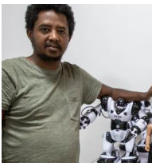
AI in Ethiopia
What if, 20 years from now, robots walked the streets alongside humans, doing many of the same jobs that you and I do today.
There is no question for Ethiopian developer, Getnet Assefa that Artificial Intelligence (AI) makes this a reality.
Getnet Assefa is a scientist and co-founder of iCog Labs, an AI research space in Addis Ababa.
iCog was part of a team of scientists that developed the software for Sophia – the world’s first humanoid robot.
Sophia has even learnt some Amharic, the developers say.
can display 60 types of facial expressions and carry a conversation.

Slide 29
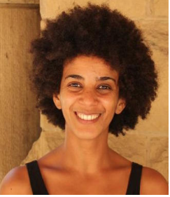
Cont’d…
iCog has customers in USA, Canada, Hong Kong and China and at home, works with the government on software and hardware development.
D.r Timnit Gebru is an Eritrean American computer scientist and the technical co-lead of the Ethical Artificial Intelligence Team at Google.
She works on algorithmic bias and data mining. She is an advocate for diversity in technology and is the cofounder of Black in AI, a community of black researchers working in artificial intelligence.
Timnit is an Eritrean origin born and raised in Ethiopia

Slide 30

THANK YOU
Q & A
?

Slide 31
CHAPTER : 2
Intelligent Agents

Slide 32
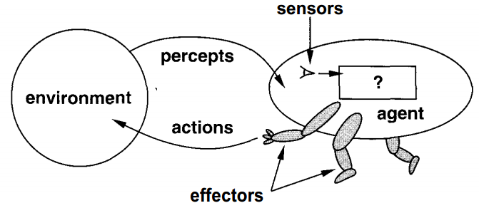
Agents and Environments
An agent: is anything that can be viewed as perceiving its environment through sensors and acting upon that environment through actuators/effectors.
Figure 1:Agents interact with environments through sensors and effectors.

Slide 33
Con’t…
A human agent: has eyes, ears, and other organs for sensors and hands, legs, vocal tract, and so on for actuators.
A robotic agent: might have cameras and infrared range finders for sensors and various motors for actuators.
A software agent: receives keystrokes, file contents, and network packets as sensory inputs and acts on the environment by displaying on the screen, writing files, and sending network packets.

Slide 34
Intelligent agents
An intelligent agent: is a system that perceives its environment, learns from it, and interacts with it intelligently.
Intelligent agents can be divided into two broad categories: software agents and physical agents.

Slide 35
Software agent
A software agent is a set of programs that are designed to do particular tasks.
For example, a software agent is a search engine used to search the World Wide Web and find sites that can provide information about a requested subject.

Slide 36
Physical agent
A physical agent (robot) is a programmable system that can be used to perform a variety of tasks.
Simple robots can be used in manufacturing to do routine jobs such as assembling, welding, or painting.
Some organizations use mobile robots that do routine delivery jobs such as distributing mail or correspondence to different rooms.

Slide 37
Acting of Intelligent Agents (Rationality)
An agent should strive to "do the right thing", based on what it can perceive and the actions it can perform.
The right action is the one that will cause the agent to be most successful.
Performance measure: An objective criterion for success of an agent's behavior.

Slide 38
Con’t…
E.g. performance measure of a vacuum-cleaner agent could be amount of dirt cleaned up, amount of time taken, amount of electricity consumed, amount of noise generated, etc.
Rational Agent: For each possible percept sequence, a rational agent should select an action that is expected to maximize its performance measure, given the evidence provided by the percept sequence and whatever built-in knowledge the agent has.

Slide 39
Con’t…
Agents can perform actions in order to modify future percepts so as to obtain useful information (information gathering, exploration)
An agent is autonomous if its behavior is determined by its own experience (with ability to learn and adapt)

Slide 40
Con’t…
In summary what is rational at any given point depends on PEAS (Performance measure, Environment, Actuators, Sensors) framework.
Performance measure
The performance measure that defines degrees of success of the agent

Slide 41
Con’t…
Environment
Knowledge: What an agent already knows about the environment
Actuators – generating actions
The actions that the agent can perform back to the environment
Sensors – receiving percepts
Perception: Everything that the agent has perceived so far concerning the current scenario in the environment

Slide 42
Example: PEAS
Consider the task of designing an automated taxi driver agent:
Performance measure: Safe, fast, legal, comfortable trip, maximize profits.
Environment: Roads, other traffic, pedestrians, customers
Actuators: Artificial legs & hands, Speaker
Sensors: Cameras, GPS, engine sensors, recorder (microphone)
Goal: driving safely from source to destination point

Slide 43
Structure of agents
Agent = architecture + program
Architecture = some sort of computing device (sensors + actuators)
(Agent) Program = some function that implements the agent mapping.
Agent Program = Job of AI

Slide 44
Agent programs
Input for Agent Program
Only the current percept.
Input for Agent Function
The entire percept sequence.
The agent must remember all of them.
Implement the agent program as
A look up table (agent function)

Slide 45
Types of agent programs
1. Simple Reflex Agents
2. Model-Based Reflex Agent
3. Goal based agents
4. Utility based agents
5. Learning Agents

Slide 46
1. Simple Reflex Agents
It works by finding a rule whose condition matches the current situation (as defined by the percept) and then doing the action associated with that rule.
These agents select actions on the basis of the current percept, ignoring the rest of the percept history.
It uses just condition-action rules
The rules are like the form “if … then …”
Because knowledge sometimes cannot be stated explicitly
Work only
if the environment is fully observable

Slide 47
Con’t…
Example: Automated taxi driving agent.
If the car in front brakes and its brake lights on, then you should notice this and initiate braking. This can be written as condition-action rule:
If car-in-front-is-braking then initiate-braking;
Humans also have many such connections, some of which are learned responses (as for driving) and some of which are innate reflexes (such as blinking when something approaches the eye).

Slide 48
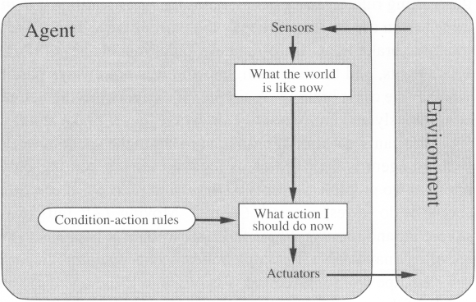
Structure of a simple reflex agent

Slide 49
Con’t…
Limitation of simple reflex agent:
The agent will work only if the environment is fully observable that is, it will work only if the correct decision can be made on the basis of only the current percept. Even a little bit of unobservability can cause serious trouble.

Slide 50
2. Model-Based Reflex Agent
It works by finding a rule whose condition matches the current situation/state.
For the world that is partially observable
The agent has to keep track of an internal state
That depends on the percept history
Reflecting some of the unobserved aspects
E.g. driving a car and changing track
Requiring two types of knowledge
How the world evolves independently of the agent
How the agent’s actions affect the world

Slide 51
Con’t…
Note: Regardless of the kind of representation used, it is seldom possible for the agent to determine the current state of a partially observable environment exactly. It can do only “best guess”.
Example: An automated taxi may not be able to see around the large truck that has stopped in front of it and can only guess about what may be causing the hold-up.

Slide 52
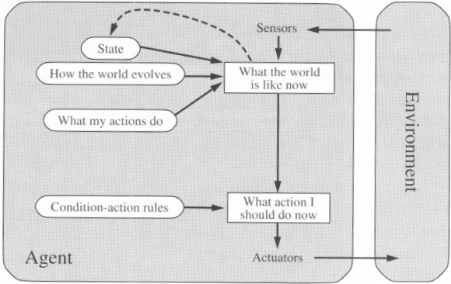
Structure of Model-Based reflex agent

Slide 53
3. Goal based agents
Knowing something about the current state of the environment is not always enough to decide what to do.
Example: At a road junction, the taxi can turn left, turn right, or go straight on. The correct decision depends on where the taxi is trying to get it.
The goal is another issue to achieve
Judgment of rationality / correctness

Slide 54
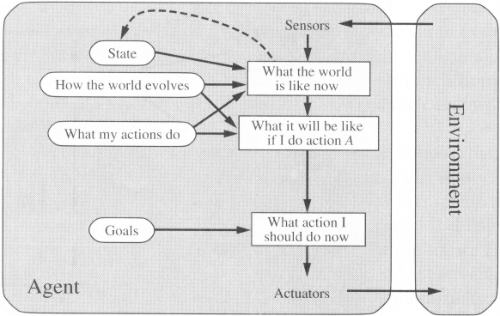
Structure of a Goal-based agent

Slide 55
Con’t…
Conclusion
Goal-based agents are less efficient
but more flexible, because the knowledge that supports its decision is represented explicitly and can be modified.
Agent ← Different goals ← different tasks
Search and planning
Two other sub-fields in AI
To find out the action sequences to achieve its goal

Slide 56
4. Utility based agents
Goals alone are not enough to generate high-quality behavior in most environments.
Example: Many action sequences will get the taxi to its destination (thereby achieving the goal) but some are quicker, safer, more reliable, or cheaper than others.
Many action sequences → the goals
Some are better and some worse
If goal means success.
Then utility means the degree of success (how successful it is)

Slide 57
Con’t…
It is said state A has higher utility
If state A is more preferred than others
Utility is therefore a function
That maps a state onto a real number
The degree of success

Slide 58
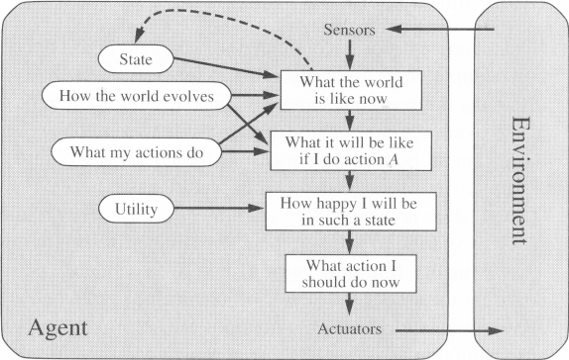
Structure of a utility-based agent

Slide 59
5. Learning Agents
After an agent is programmed, can it work immediately?
No, it still need teaching
In AI
Once an agent is done
We teach it by giving it a set of examples
Test it by using another set of examples
We then say the agent learns
A learning agent

Slide 60
Con’t…
Four conceptual components
Learning element: Responsible for making improvements.
Performance element: Responsible for selecting external actions.
Critic: Tells the Learning element how well the agent is doing with respect to fixed performance standard.
Problem generator: Suggest actions that will lead to new and informative experiences.

Slide 61
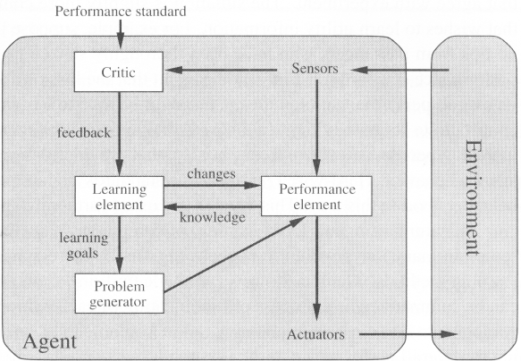
Structure of Learning Agents

Slide 62
THANK YOU
Q & A
?

Slide 63
Quiz one 5%
1. Why an agent uses sensor and actuator?
2. What does it mean AI?
3. Do you think that are you an intelligence? If you say yes or No? Why and what are the characteristics of you?

Slide 64
CHAPTER - 3
SOLVING PROBLEMS BY SEARCHING AND CONSTRAINT SATISFACTION PROBLEM
By: Wondifraw Manaye

Slide 65
INTRODUCTION
What is a Problem?
It is a gap between what actually is and what is desired.
A problem exists when an individual becomes aware of the existence of a significant difference between the expected and the actual situation, which is an obstacle and makes it difficult to achieve a desired goal or objective.

Slide 66
Con’t…
Problem solving by searching: How an agent can find a sequence of actions that achieve its goals when no single action will do.
Goal based agents: consider future actions and desirability of their outcomes.
A problem-solving agent: is a kind of goal based agent.
Use atomic representations - that is, states of the world are considered as wholes, with no internal structure visible to problem solving algorithms.
Planning Agents: Goal based agents that use more advanced factored or structured representations are called planning agents.

Slide 67
Problem-Solving Agents
It is known as, if the agent can adopt a goal and aim at satisfying it.
Example: Imagine an agent in the city of Arad, Romania enjoying a touring holiday. The agent’s performance measure contain many factors - enjoying, sights visited etc.,
Now, suppose the agent has a nonrefundable ticket to fly out to Bucharest the following day. In that case, it makes sense for the agent to adopt the goal of getting to Bucharest.
Goals help to organize behavior by limiting the objectives that the agent is trying to achieve and hence the actions it needs to consider.

Slide 68
Goal Formulation
Based on the current situation and the agent’s performance measure, is the first step in problem solving.
We will consider a goal to be a set of world states exactly those states in which the goal is satisfied.
The agent’s task is to find out how to act, now and in the future, so that it reaches a goal state.

Slide 69
Problem Formulation
It is the process of deciding what actions and states to consider, given a goal.
Example: Let us assume that the agent will consider actions at the level of driving from one major town to another. Each state corresponds to being in a particular town.
While “examining future actions”, we have to be more specific about properties of the environment.

Slide 70
In our example, we assume that the environment is:-
Observable:- the agent always knows the current state.
For the agent driving in Romania, it’s reasonable to suppose that each city on the map has a sign indicating its presence to arriving drivers.
Discrete:- at any given state there are only finitely many actions to choose from.
This is true for navigating in Romania because each city is connected to a small number of other cities.

Slide 71
Con’t…
Known:- the agent has known which states are reached by each action.
Having an accurate map suffices to meet this condition.
Deterministic:- each action has exactly one outcome.
It means that if an agent chooses to drive from Arad to Sibiu, it does end up in Sibiu.
Search: The process of looking for a sequence of actions that reaches the goal is called search.

Slide 72
Con’t…
Solution: A search algorithm takes a problem as input and returns a solution in the form of an action sequence.
Execution: Once a solution is found, the action it recommends can be carried out. This is called the execution phase.
Open-Loop: While the agent is executing the solution sequence it ignores its percepts when choosing an action because it knows in advance what they will be is called open-loop system, because ignoring the percepts breaks the loop between agent and environment.

Slide 73
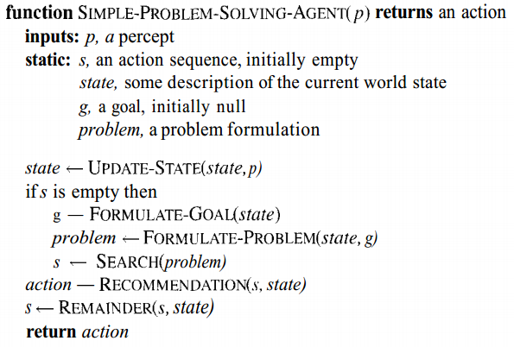
Fig. 1 A simple problem solving agent. It first formulates a goal and a problem, searches for a sequence of actions that would solve the problem, and then executes the actions one at a time. When this is complete, it formulates another goal and starts over

Slide 74
Well-defined problems and solutions
A problem can be defined formally by five components.
1. Initial State: That the agent starts in.
In our example, the initial state for our agent in Romania might be described as In (Arad).
2. Actions: A description of possible actions available to the agent.
Given a particular state s, ACTIONS (s) returns the set of actions that can be executed in s. We say that each of these actions is applicable in s.
In our example, from the state In (Arad), the applicable actions are
{Go (Sibiu), Go (Timisoara), Go (Zerind)}

Slide 75
Con’t…
3. Transition model or Successor: A description of what each action does, specified by a function.
RESULT (s, a) that returns the state that results from doing action a in state s.
In our example, RESULT (In (Arad), Go (Zerind)) = In (Zerind).
Together the initial state, actions and transition model implicitly define the state space of the problem the set of all states reachable from the initial state by any sequence of actions.

Slide 76
Con’t…
4. Goal Test: Which determines whether a given state is a goal state.
Sometimes there is an explicit set of possible goal states, and the test simply checks whether the given state is one of them.
In our example, the agent’s goal in Romania is the singleton set {In (Bucharest)}.
5. Path Cost: A function that assigns a numeric cost to each path.
For the agent trying to get to Bucharest, time is of the essence, so the cost of a path might be its length in kilometers.
We assume that the cost of a path can be described as the sum of the costs of the individual actions along the path. The step cost of taking action a in state s to reach state s¹ is denoted by c(s, a, s¹).

Slide 77
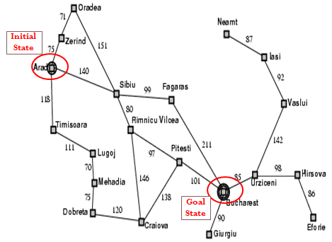
For example, consider the map of Romania in Figure.2

Slide 78
The problem formulation is therefore:
Initial state: at Arad
Actions: the successor function S:
S(Arad) = {<Arad→Zerind, Zerind>, <Arad→Sibiu, Sibiu>,<Arad→Timisoara, Timisoara}
S(Sibiu) = {<Sibiu→Arad, Arad>, <Sibiu→Oradea, Oradea>, < Sibiu→ Fagaras, Fagaras>, Sibiu→Rimnicu Vilcea, Rimnicu Vilcea>}, etc.
Goal test: at Bucharest
Path cost: c(Arad, Arad→Zerind, Zerind) = 75, c(Arad, Arad→Sibiu, Sibiu) = 140, c(Arad, Arad→ Timisoara, Timisoara) = 118, etc.

Slide 79
Con’t…
For example, if the agent is in the state Arad, there are 3 possible actions, Arad → Zerind, Arad → Sibiu and Arad → Timisoara, resulting in the states Zerind, Sibiu and Timisoara respectively.
The solution to drive from Arad to Bucharest is Arad to Sibiu to Rimnicu Vicea to Pitesti to Bucharest must be a solution.

Slide 80
Example problems:
Toy problem: is intended to illustrate or exercise various problem solving methods.
It can be given a brief, exact description and hence is usable by different researchers to compare the performance of algorithms.
Real world problems: is one whose solutions people actually care about.
Such problem tends not to have a single agreed-upon description, but we can give the general flavor/taste of their formulations.

Slide 81
Toy problems:
1. 8-Puzzle: Consists of a 3×3 board with eight numbered tiles and a blank space. A tile adjacent to the blank space can slide into the space. The objective is to reach a specified goal state.

Slide 82
Con’t…
States: A state description specifies the location of each of the eight tiles and the blank in one of the nine squares.
Initial State: Any state can be designated as the initial state. Note that any given goal can be reached from exactly half of the possible initial states.
Actions: The simplest formulation defines the action on movements of the blank space Left, Right, Up or Down.
Transition Model: Given a state and action, this returns the resulting state.
Example: If we apply left to the start state in figure, the resulting state has the 5 and the blank switched.

Slide 83
Con’t…
Goal Test: This checks whether the state matches the goal configuration as shown in figure.
Path cost: Each cost costs 1, so the path cost in the number of steps in the path.
Note: The 8-puzzle belongs to the family of sliding-block puzzles, which are often used as test problems for new search algorithms in AI.

Slide 84
Real World problems:
1. Route-finding problem: is defined in terms of specified locations and transitions along links between them.
Route-finding algorithms are used in a variety of applications such as, websites, in car systems to provide driving directions, routing video streams in computer networks, military operations planning, airline travel planning systems.

Slide 85
Consider the air line travel problems: that must be solved by a travel-planning web site:
States: Each state obviously includes a location (airport) and the current time. Furthermore, the state must record extra information like, base fare, flight segment, their status as domestic or international, to decide the cost of an action.
Initial state: This is specified by the user’s query.
Actions: Take any flight from the current location, in any seat class, leaving the current time, leaving enough time for within airport transfer if needed.

Slide 86
Con’t…
Transition model: The state resulting from taking a flight will have the flight’s destination as the current location and the flight’s arrival time as the current time.
Goal Test: Are the final destination specified by the user?
Path cost: This depends on monetary cost, waiting time, flight time, customs and immigration procedures, seat quality, time of day, type of airplane, frequent flyer mileage awards and so on.

Slide 87
THANK YOU
Q & A
?

Slide 88
Chapter Four
Knowledge and Reasoning

Slide 89
Knowledge: What and Why?
Knowledge includes facts about the real world entities and the relationship between them.
Why Knowledge is important?
We are living in complex environment where there are:
Many actors, prosumers, strong competitors, and high turn over
It enables to:
Automate reasoning , Discover new facts, Deduce new facts that follow from the KB, and Answer users queries
Make quality decisions - select courses of actions, etc.
Notes:
A person in postindustrial society who combines the economic roles of producer and consumer.

Slide 90
Knowledge Base Agent
Knowledge base agent is an agent that perform action using the knowledge it has and reason about their action using its inference procedure.
Consists of two parts:
knowledge base: contains the domain-specific knowledge that the agent has of its environment. This can consist of facts, but also rules that describe the structure of the environment.
Inference engine: It consists of algorithms that take the contents of the knowledge base and infer (i.e. deduce) new knowledge about the world.

Slide 91

Con’t…
Knowledge base is a set of representation of facts and their relation ships called rules about the world
Each fact/rules are called sentences which is represented using a language called knowledge representation language.

Slide 92
Con’t…
Declarative approach to building an agent (or other system):
Tell it what it needs to know (Knowledge base)
Ask what it knows
Answers should follow from the KB
The agent must be able to:
Represent states of the world, actions, etc.
Incorporate new percepts (facts and rules)
Deduce hidden properties of the world
Deduce appropriate actions
Update internal representations of the world

Slide 93
Logical Agents
Logic is the study of principles of reasoning and arguments towards the truth of a given conclusion given premises.
Logic in AI is the key idea for KB design, KB representation and inferencing (reasoning).
Logic is formal languages use for representing information so that conclusions can be drawn.
Logic is the systematic study of the general conditions of valid inferences.

Slide 94
Con’t…
A logic consists of a syntax and some semantics.
The syntax defines what an allowable sentence is in the language, whereas the semantics defines the meaning of the sentences.
There are many different logics. For example, integer arithmetic is a logic. The syntax of integer arithmetic states that the following are all legal sentences:
1 + 4 = x
x – 4 > 2
x² – 2x = 0
whereas the following are illegal sentences:
1 + * 2 =
x2 + y > {}

Slide 95
Entailment
The idea that a sentence follows logically from another sentence.
α╞ β (i.e, the sentence α entails the sentence β; (or) the sentence β logically follows from sentence α)
The formal definition of entailment is this: α ╞ β if and only if, in every model in which α is true, β is also true.
It can be written as, α ╞ β if and only if m(α) m (β).

Slide 96
Models
The semantics of a logic define the truth (or otherwise) of sentences in possible worlds.
A world is an assignment of values to variables.
For example: we can say that the integer arithmetic sentence “x + y = 4” is true in the world where x = 2 and y = 2.
Logicians often refer to models rather than worlds, but the meaning is the same: an assignment of values to variables.
Definition: A model M is a model of a sentence α if α is true in M

Slide 97
Con’t…
For example: The model {x = 2, y = 2} is a model of the sentence
“x + y = 4”.
In addition, the model {x = 1, y = 3} is also a model of the sentence “x + y = 4”. In fact, because there are an infinite number of integers, there are an infinite number of models of this sentence.
Definition: M(α) is the set of all models of α

Slide 98
Propositional(Boolean) Logic
Proposition is statement which is either true or false but not both at any time.
A statement is a sentence which is either true or false.
PL uses declarative sentences only
PL doesn’t involve quantifiers.
Not all sentences are statement (interrogatives, imperatives and exclamatory)

Slide 99
Con’t…
Preposition can be conditional or unconditional
Examples
Socrates is mortal (unconditional)
If the winter is severe, students will not succeed. (conditional)
All are the same if their color is black (conditional)
In propositional logic, symbols represent the whole preposition.
Examples:
M = Socrates is mortal
W = winter is sever
S = students will not succeed

Slide 100
Con’t…
Preposition symbols can be combined using Boolean connectives to generate new preposition with complex meaning
Symbols involved in PL:
Logical constants (TRUE and FALSE)
Preposition symbols (also called atomic symbols) like M, W, S
Logical connectives
¬ (negation),
∧ (conjunction),
∨ (disjunction),
⇔ (bi-implication or equivalence),
⇒ (implication) and parenthesis

Slide 101
Con’t…
A simple language useful for showing key ideas and definitions
User defines a set of propositional symbols, like P and Q.
User defines the semantics of each propositional symbol:
P means “It is hot”
Q means “It is humid”
R means “It is raining”

Slide 102
Con’t…
A sentence (well formed formula) is defined as follows:
A symbol is a sentence
If S is a sentence, then ¬S is a sentence
If S is a sentence, then (S) is a sentence
If S and T are sentences, then (S ∨ T), (S ∧ T), (S → T), and (S ↔ T) are sentences
A sentence results from a finite number of applications of the above rules

Slide 103
Examples of PL sentences
(P ∧ Q) → R
“If it is hot and humid, then it is raining”
Q → P, “If it is humid, then it is hot”
Q , “It is humid.”
A better way:
Ho = “It is hot”
Hu = “It is humid”
R = “It is raining”

Slide 104
Some terms
The meaning or semantics of a sentence determines its interpretation.
Given the truth values of all symbols in a sentence, it can be “evaluated” to determine its truth value (True or False).
A model for a KB is a “possible world” (assignment of truth values to propositional symbols) in which each sentence in the KB is True.

Slide 105
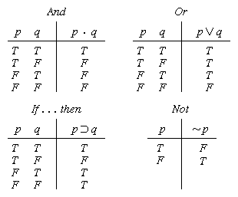
Truth tables I

Slide 106

Truth tables II

Slide 107
Knowledge Representation and reasoning
Knowledge Representation: express knowledge explicitly in a computer-tractable way such that the agent can reason out.
Parts of KR language:
Syntax of a language: describes the possible configuration to form sentences.
E.g. if x & y denote numbers, then x > y is a sentence about numbers

Slide 108
Con’t…
Semantics: determines the facts in the world to which the sentences refer.
E.g. x > y is false when y is greater than x and true otherwise
Reasoning: is the process of constructing new sentences from existing facts in the KB.
Proper reasoning ensures that the new configuration represent facts that actually follow from the facts in the KB.

Slide 109
Knowledge-based Systems and Knowledge
What is a knowledge-based system?
A system which is built around a knowledge base. i.e. a collection of knowledge, taken from a human, and stored in such a way that the system can reason with it.
What is knowledge?
Knowledge is the sort of information that people use to solve problems.

Slide 110
Con’t...
Knowledge includes:
facts, concepts, procedures, models, heuristics, examples.
Knowledge may be:
specific or general
exact or fuzzy
procedural or declarative

Slide 111
THANK YOU
Q & A
?

Slide 112
CHAPTER-SIX
LEARNING

Slide 113
Learning from Examples:
In which we describe agents that can improve their behavior through diligent study of their own experiences.
An agent is learning if it improves its performance on future tasks after making observations about the world.

Slide 114
Learning
Learning is essential for unknown environments.
Learning is useful as a system construction method.
i.e., expose the agent to reality rather than trying to write it down
Learning modifies the agent's decision mechanisms to improve performance

Slide 115
Why would we want an agent to learn?
There are three main reasons:
The designers cannot anticipate all possible situations that the agent might find itself in.
Example: a robot designed to navigate mazes must learn the layout of each new maze it encounters.
The designers cannot anticipate all changes over time.
Sometimes human programmers have no idea how to program a solution themselves.

Slide 116
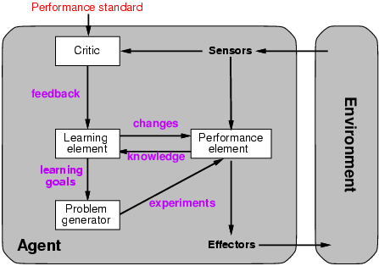
Learning agents

Slide 117
Learning agents consist of four main components:
Learning element: the part of the agent responsible for improving its performance
Performance element: the part that chooses the actions to take
Critic: provides feedback for the learning element how the agent is doing with respect to a performance standard
Problem generator: suggests actions that could lead to new, informative experiences

Slide 118
Forms of learning: (factors for designing a learning agent)
Any component of an agent can be improved by learning from data. The improvements is depend on four major factors.
Which components of the performance element are to be learned.
What prior knowledge the agent already has.
What feedback is available to learn these components.
What representation is used for the components.

Slide 119






Types of Learning
Supervised learning: The agent observes some example input-output pairs and learns a function that maps from input to output, correct answer for each.
Example. Answer can be a numeric variable, categorical variable etc.
Unsupervised learning: correct answers not given – just examples (e.g. – the same figures as above , without the labels)
Reinforcement learning: the agent learns from a series of reinforcements-rewards or punishments.
M
M
F
F
M
F

Slide 120
Inductive learning
In inductive learning we assume that all inputs and outputs to the function we want to learn are known, and that we have no prior knowledge of the problem domain.
In general terms, we have a set of examples, each consisting of an input and an output.
The outputs were generated by some unknown function of the inputs.
The aim of the learning algorithm is to determine the function, given just the inputs and outputs.

Slide 121
Con’t…
It is a teaching strategy that emphasize the importance of developing a student evidence gathering and critical thinking skills.
Simplest form: learn a function from examples
f is the target function
An example is a pair (x, f(x))
Problem: find a hypothesis h
such that h ≈ f
given a training set of examples
This is a highly simplified model of real learning.

Slide 122
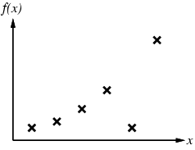
Inductive learning method
Example: Figures next shows a set of examples: each has an input value, x, and an output value f(x). Now we want to find a hypothesis, h, such that h is an approximation of f.
Construct/adjust h to agree with f on training set
(h is consistent if it agrees with f on all examples)
E.g., curve fitting:
Figure 1 – Inductive learning: (A) a set of input/output examples

Slide 123
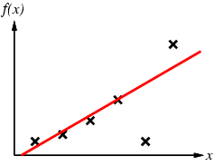
Con’t…
Construct/adjust h to agree with f on training set
(h is consistent if it agrees with f on all examples)
E.g., curve fitting:
Figure 1 – Inductive learning: (B) a set of input/output examples

Slide 124
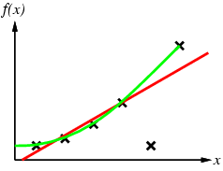
Con’t…
Construct/adjust h to agree with f on training set
(h is consistent if it agrees with f on all examples)
E.g., curve fitting:
Figure 1 – Inductive learning: (C) a set of input/output examples

Slide 125
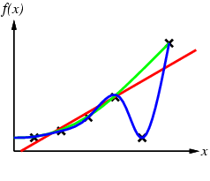
Con’t…
Construct/adjust h to agree with f on training set
(h is consistent if it agrees with f on all examples)
E.g., curve fitting:
Figure 1 – Inductive learning: (D) a set of input/output examples

Slide 126
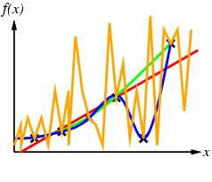
Con’t…
Construct/adjust h to agree with f on training set
(h is consistent if it agrees with f on all examples)
E.g., curve fitting:
Figure 1– Inductive learning: (E) a set of input/output examples

Slide 127
Con’t…
Construct/adjust h to agree with f on training set
(h is consistent if it agrees with f on all examples)
E.g., curve fitting:
Ockham’s razor: prefer the simplest hypothesis consistent with data
Figure 1– Inductive learning: (F) a number of possible curves that fit the data.

Slide 128
Learning decision trees
Problem: decide whether to wait for a table at a restaurant, based on the following attributes:
Alternate: is there an alternative restaurant near by?
Bar: is there a comfortable bar area to wait in?
Fri/Sat: is today Friday or Saturday?
Hungry: are we hungry?
Patrons: number of people in the restaurant (None, Some, Full)
Price: price range ($, $$, $$$)
Raining: is it raining outside?
Reservation: have we made a reservation?
Type: kind of restaurant (French, Italian, Thai, Burger)
Wait Estimate: estimated waiting time (0-10, 10-30, 30-60, >60)

Slide 129
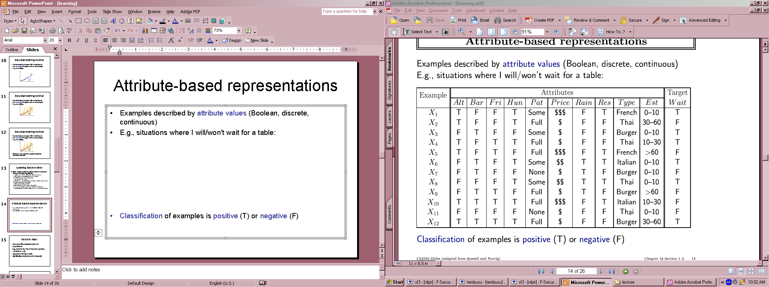
Attribute-based representations
Examples described by attribute values (Boolean, discrete, continuous)
E.g., situations where I will/won't wait for a table:
Classification of examples is positive (T) or negative (F)
The set of examples used for learning is called training set.

Slide 130
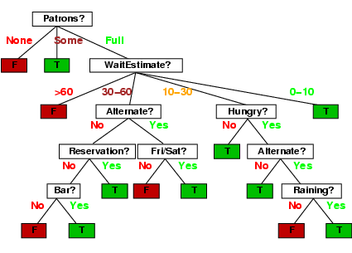
Decision trees
One possible representation for hypotheses
E.g., here is the “true” tree for deciding whether to wait:

Slide 131
Probabilistic Models
A probabilistic model of sensory inputs can:
Make optimal decisions under a given loss function
Make inferences about missing inputs
Generate predictions/fantasies/imagery
Communicate the data in an efficient way

Slide 132
Bayesian Learning
Why Bayesian Classification?
Provides practical learning algorithms
Probabilistic learning: Calculate explicit probabilities for hypothesis. E.g. Naïve Bayes
Prior knowledge and observed data can be combined
Incremental: Each training example can incrementally increase/decrease the probability that a hypothesis is correct.

Slide 133
Con’t...
It is a generative (model based) approach, which offers a useful conceptual framework
Probabilistic prediction: Predict multiple hypotheses, weighted by their probabilities.
E.g. sequences could also be classified, based on a probabilistic model specification
Any kind of objects can be classified, based on a probabilistic model specification

Slide 134
Conditional Probability
Probability: How likely is it that an event will happen?
Sample Space S
An event A and C are a subset of S
P(C / A)- Probability that event C occurs given that event A has already occurred.

Slide 135
Con’t
Example of conditional probability:
There are 2 baskets. B₁ has 2 red ball and 5 blue ball. B₂ has 4 red ball and 3 blue ball.
Find probability of picking a red ball from basket 1?
P(red ball | basket 1) = 2/7
What about P(basket2 | red ball) ?

Slide 136
Review Question (Quiz Two 5%)
1. Do you think is that, have you a knowledge? And what does it mean? for what purpose you implement?
2. When an agent act under uncertainty?
3. Do you think that can we learn by observation? If you say yes describe your reason using example?

Slide 137
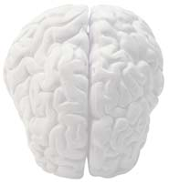
ARTIFICIAL NEURAL NETWORKS

Slide 138
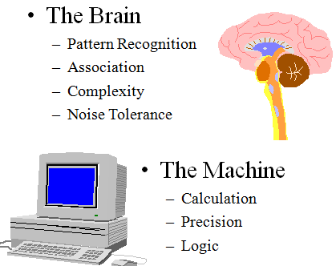
Brain vs. Machine

Slide 139

Features of the Brain
There are around ten billion (10¹⁰) neurons in our brain
Neuron switching time >10⁻³secs
Face Recognition ~0.1secs
On average, each neuron has several thousand connections
Hundreds of operations per second
High degree of parallel computation
Distributed representations
Compensated for problems by massive parallelism

Slide 140
Neural Network
It is represented as a layered set of interconnected processors.
These processor nodes has a relationship with the neurons of the brain.
Each node has a weighted connection to several other nodes in adjacent layers.
Individual nodes take the input received from connected nodes and use the weights together to compute output values.

Slide 141
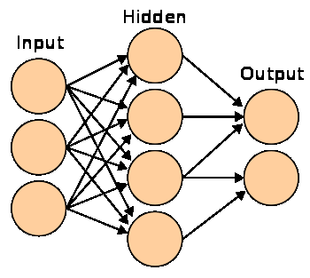
Con’t…
The inputs are fed simultaneously into the input layer.
The weighted outputs of these units are fed into hidden layer.
The weighted outputs of the last hidden layer are inputs to units making up the output layer.

Slide 142
Architecture of Neural network
Neural networks are used to look for patterns in data, learn these patterns, and then classify new patterns & make forecasts
A network with the input and output layer only is called single-layered neural network. Whereas, a multilayer neural network is a generalized one with one or more hidden layer.

Slide 143
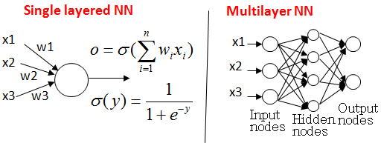
Con’t…
A network containing two hidden layers is called a three-layer neural network, and so on.

Slide 144
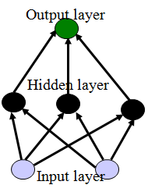
A Multilayer Neural Network
INPUT: records with class attribute with normalized attributes values.
INPUT VECTOR: X = { x₁, x₂, …. x_{n}}, where n is the number of attributes.
INPUT LAYER – there are as many nodes as class attributes i.e. as the length of the input vector.

Slide 145
Con’t…
HIDDEN LAYER – neither its input nor its output can be observed from outside.
- The number of nodes in the hidden layer and the number of hidden layers depends on implementation.
OUTPUT LAYER – corresponds to the class attribute.
There are as many nodes as classes (values of the class attribute).
Ok, where k= 1, 2,.. n, where n is number of classes

Slide 146
Pros and Cons of Neural Network
Useful for learning complex data like handwriting, speech and image recognition
Pros
Can learn more complicated class boundaries
Fast application
Can handle large number of features
Cons
Slow training time
Hard to interpret
Hard to implement: trial and error for choosing number of nodes
Neural Network needs long time for training.
Neural Network has a high tolerance to noisy and incomplete data

Slide 147
THANK YOU
Q & A
?

Slide 148
CHAPTER-SEVEN
COMMUNICATING, PERCEIVING, AND ACTING

Slide 149
Natural Language Processing (NLP)
The process of computer analysis of input provided in a human language (natural language), and conversion of this input into a useful form of representation.
NLP is primarily concerned with getting computers to perform useful and interesting tasks with human languages.
NLP is secondarily concerned with helping us come to a better understanding of human language.

Slide 150
Forms of Natural Language
The input/output of a NLP system can be:
written text
speech
We will mostly concerned with written text (not speech).
To process written text, we need:
Lexical, syntactic, semantic knowledge about the language
discourse information, real world knowledge
To process spoken language, we need everything required to process written text, plus the challenges of speech recognition and speech synthesis.

Slide 151
Components of NLP
1. Natural Language Understanding
Taking some spoken/typed sentence and working out what it means
Mapping the given input in the natural language into a useful representation.
Different level of analysis required:
morphological analysis,
syntactic analysis,
semantic analysis,
discourse analysis, …

Slide 152
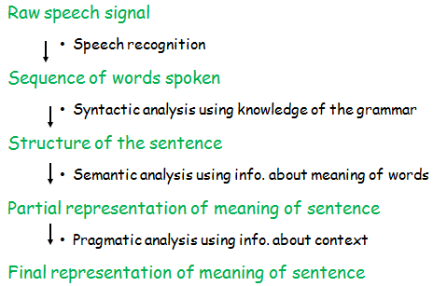
Con’t…

Slide 153
Con’t…
2. Natural Language Generation
Taking some formal representation of what you want to say and working out a way to express it in a natural (human) language (e.g., English).
NLG can be viewed as the reverse process of NL understanding.
A NLG system may have two main parts:
Discourse Planner - what will be generated. which sentences.
Surface Realizer - realizes a sentence from its internal representation.
Lexical Selection - selecting the correct words describing the concepts.

Slide 154
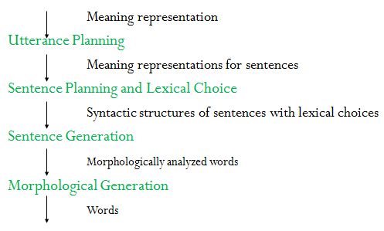
Con’t…

Slide 155
Applications of NLP
Machine Translation
Database Access
Information Retrieval
Selecting from a set of documents the ones that are relevant to a query
Text Categorization
Sorting text into fixed topic categories
Extracting data from text
Converting unstructured text into structure data
Spoken language control systems
Spelling and grammar checkers

Slide 156
Why NL Understanding is hard?
Natural language is extremely rich in form and structure, and very ambiguous.
How to represent meaning,
Which structures map to which meaning structures.
One input can mean many different things. Ambiguity can be at different levels.
Lexical (word level) ambiguity - different meanings of words
Syntactic ambiguity - different ways to parse the sentence
Interpreting partial information - how to interpret pronouns
Contextual information - context of the sentence may affect the meaning of that sentence.
Many input can mean the same thing.
Interaction among components of the input is not clear.

Slide 157
Knowledge of Language
Phonology – concerns how words are related to the sounds that realize them.
Morphology – concerns how words are constructed from more basic meaning units called morphemes.
- A morpheme is the primitive unit of meaning in a language.
Syntax – concerns how can be put together to form correct sentences and determines what structural role each word plays in the sentence and what phrases are subparts of other phrases.
Semantics – concerns what words mean and how these meaning combine in sentences to form sentence meaning.
- The study of context-independent meaning.

Slide 158
Con’t…
Pragmatics – concerns how sentences are used in different situations and how use affects the interpretation of the sentence.
Discourse – concerns how the immediately preceding sentences affect the interpretation of the next sentence. For example, interpreting pronouns and interpreting the temporal aspects of the information.
World Knowledge – includes general knowledge about the world. What each language user must know about the other’s beliefs and goals.

Slide 159
Ambiguity
I made her duck.
How many different interpretations does this sentence have?
What are the reasons for the ambiguity?
The categories of knowledge of language can be thought of as ambiguity resolving components.
How can each ambiguous piece be resolved?
Does speech input make the sentence even more ambiguous?
Yes – deciding word boundaries

Slide 160
Con’t…
Some interpretations of : I made her duck.
I cooked duck for her.
I cooked duck belonging to her.
I created a toy duck which she owns.
I caused her to quickly lower her head or body.
I used magic and turned her into a duck.
duck – morphologically and syntactically ambiguous: noun or verb.
her – syntactically ambiguous: dative or possessive.
make – semantically ambiguous: cook or create.
make – syntactically ambiguous:
Transitive – takes a direct object. => 2
Di-transitive – takes two objects. => 5
Takes a direct object and a verb. => 4

Slide 161
Resolve Ambiguities
We will introduce models and algorithms to resolve ambiguities at different levels.
part-of-speech tagging - Deciding whether duck is verb or noun.
word-sense disambiguation - Deciding whether make is create or cook.
lexical disambiguation - Resolution of part-of-speech and word-sense ambiguities are two important kinds of lexical disambiguation.
syntactic ambiguity - her duck is an example of syntactic ambiguity, and can be addressed by probabilistic parsing.

Slide 162
Natural Language for Communication
The goal in the production and comprehension of natural language is for communication.
Communication for the speaker:
Intention: Decide when and what information should be transmitted (strategic generation).
- May require planning and reasoning about agents’ goals and beliefs. Generation: Translate the information to be communicated into string of words in desired natural language (tactical generation). Synthesis: Output the string in desired modality, text or speech.

Slide 163
Con’t…
Communication for the hearer:
Perception: Map input modality to a string of words, e.g. optical character recognition (OCR) or speech recognition. Analysis: Determine the information content of the string. Syntactic Interpretation (parsing): Find the correct parse tree showing the phrase structure of the string. Semantic Interpretation: Extract the (literal) meaning of the string (logical form). Pragmatic Interpretation: Consider effect of the overall context on altering the literal meaning of a sentence. Incorporation: Decide whether or not to believe the content of the string and add it to the KB.

Slide 164
Speech Recognition
Speech is the dominant modality for communication between humans, and promises to be important for communication between humans and machines.
Speech recognition: is the task of mapping from a digitally encoded acoustic signal to a string of words.
Speech understanding: is the task of mapping from the acoustic signal all the way to an interpretation of the meaning of the word.

Slide 165
Con’t…
A speech understanding system must answer three questions:
What speech sounds did the speaker utter?
What words did the speaker intend to express with those speech sounds?
What meaning did the speaker intend to express with those words?

Slide 166
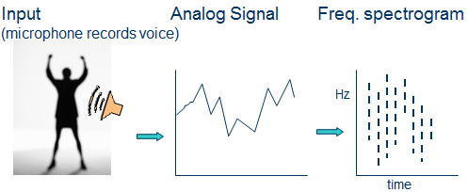
Con’t…

Slide 167
Con’t…
Frequency spectrogram
Basic sounds in the signal (40-50 phonemes)
(e.g. “a” in “cat”)
Template matching against db of phonemes
Constructing words from phonemes
(e.g. “th”+”i”+”ng”=thing)
Words

Slide 168
Speech Recognition-Complications
No simple mapping between sounds and words
Variance in pronunciation due to gender, dialect, …
Restriction to handle just one speaker
Same sound corresponding to different words
e.g. bear, bare
Finding gaps between words
“how to recognize speech”
“how to wreck a nice beach”
Noise

Slide 169
Perception
Perception provides an agent with information about the world they inhabit
Provided by sensors
Anything that can record some aspect of the environment and pass it as input to a program

Slide 170
Con’t…
There are basically two approaches for perception
Feature Extraction
Detect some small number of features in sensory input and pass them to their agent program
Agent program will combine features with other information
“bottom up”
Model Based
Sensory stimulus is used to reconstruct a model of the world.
Start with a function that maps from a state of the world to a stimulus
“top down”

Slide 171
Con’t…
In reality, both feature extraction and model-based approaches are needed.
Not well understood how to combine these approaches
Knowledge representation of the model is the problem

Slide 172
Robotic
Robots are physical agents that perform tasks by manipulating the physical world.
Equipped with Effectors such as legs, wheels, joints, and grippers.
Also equipped with Sensors to perceive their environment, sensors include cameras and ultrasound to measure the environment’.

Slide 173
Types of Robots
1.Manipulators: Manipulators or robot arms are physically anchored to their workplace, for example robots in a factory assembly line.
2.Mobile robots: Mobile robots move around their environment using wheels, legs or similar mechanisms.
3.Hybrid type robots: Mobile robot equipped with manipulators, these include the humanoid robot, whose physical design mimics the human torso.

Slide 174
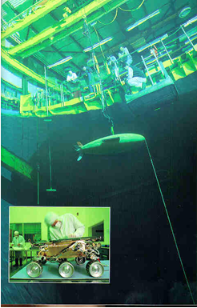
Modern uses of Robots
1. Explorations:

Slide 175
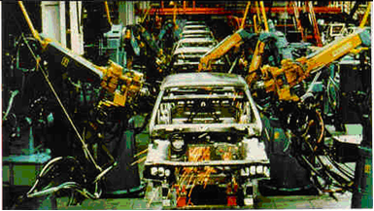
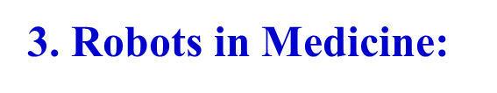
Con’t…
2. Industry Robots:

Slide 176
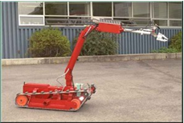
Con’t…
4. In Military and Police corps:
5. Entertainment Robots:

Slide 177
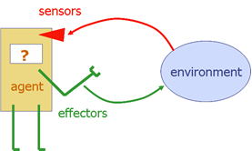
Robot hardware
The success of real robots depends at least as much on the design of sensors and effectors that are appropriate for the task.
Fig: Robot hardware

Slide 178
Review Question
What do you learn in general from this course?
What is the importance of NLP?
Why NL Understanding is hard?
Define the following terms
- lexical selection
- speech recognition

Slide 179
About Your feeling
What do you feel about the course?
How do you see the teaching learning process?
Do you have any comment/suggestion?

